Slide 1
Olist Marketplace
Payment/Monetization Analysis

Slide 2
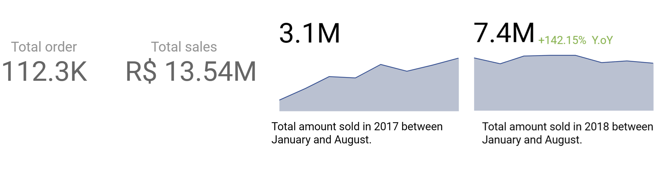
KPI between 2017-2018
2017
2018

Slide 3
How about the e-commerce sales? Did they grow up over time?

Slide 4
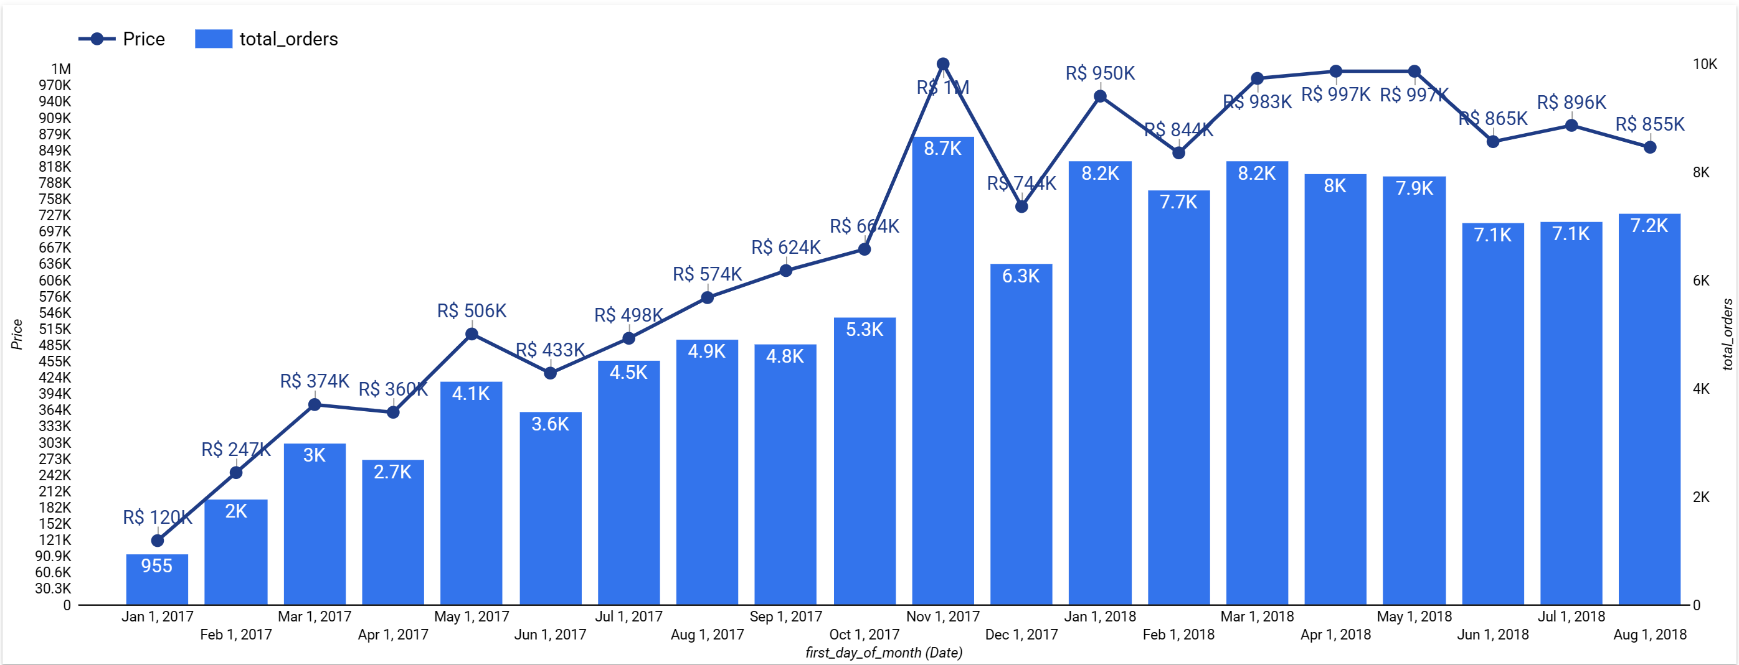
Total sales vs total orders

Slide 5
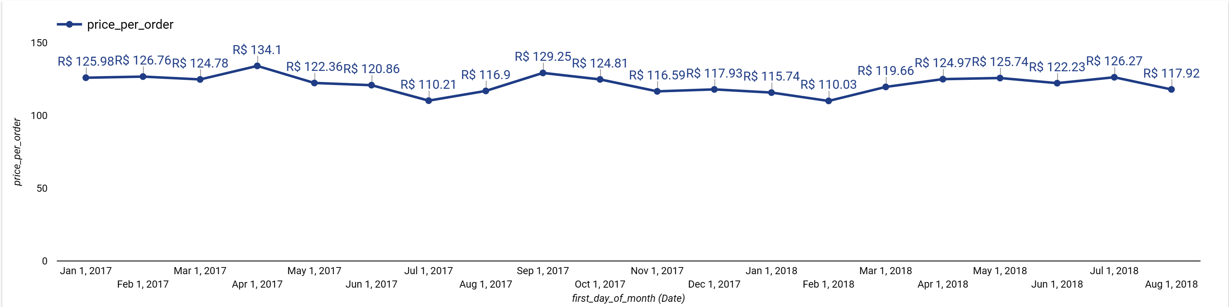
Average price per order

Slide 6
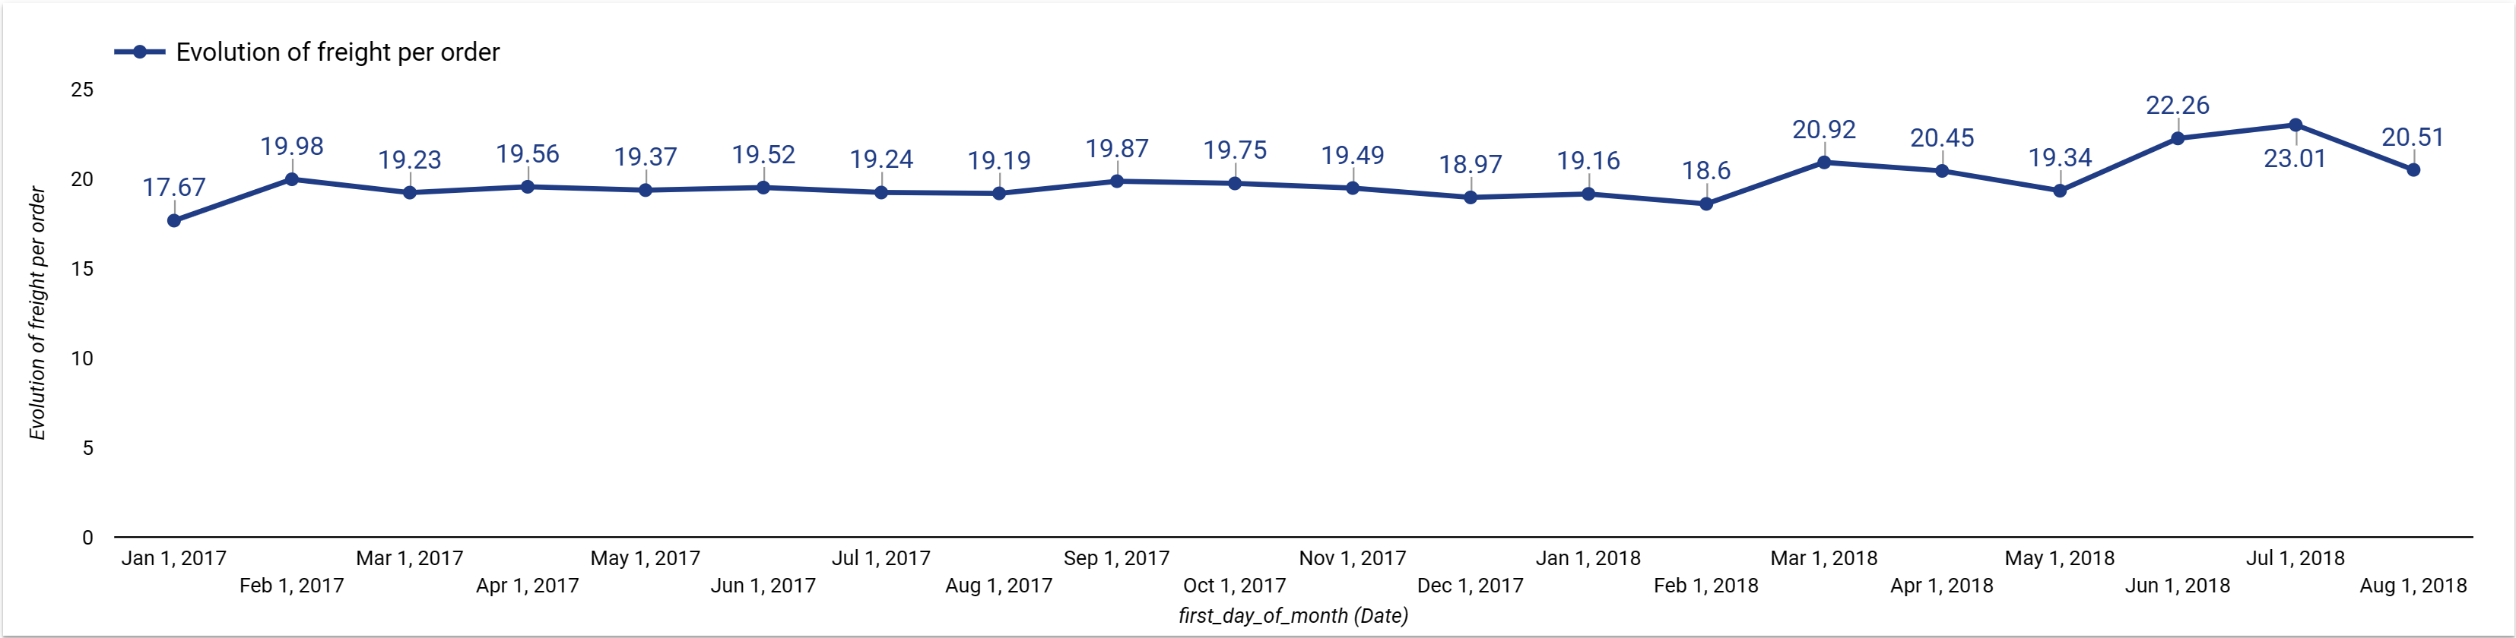
Evolution of freight per order

Slide 7
How are the total sales (sum of price) and average order value concentrated in all Brazilian states?

Slide 8
Top 5 state with the highest average order value
PB
115.2k total sales
PB
AL
192
AL
AC
182
80.2k total sales
RO
174
PA
166
AC
166
16k total sales

Slide 9
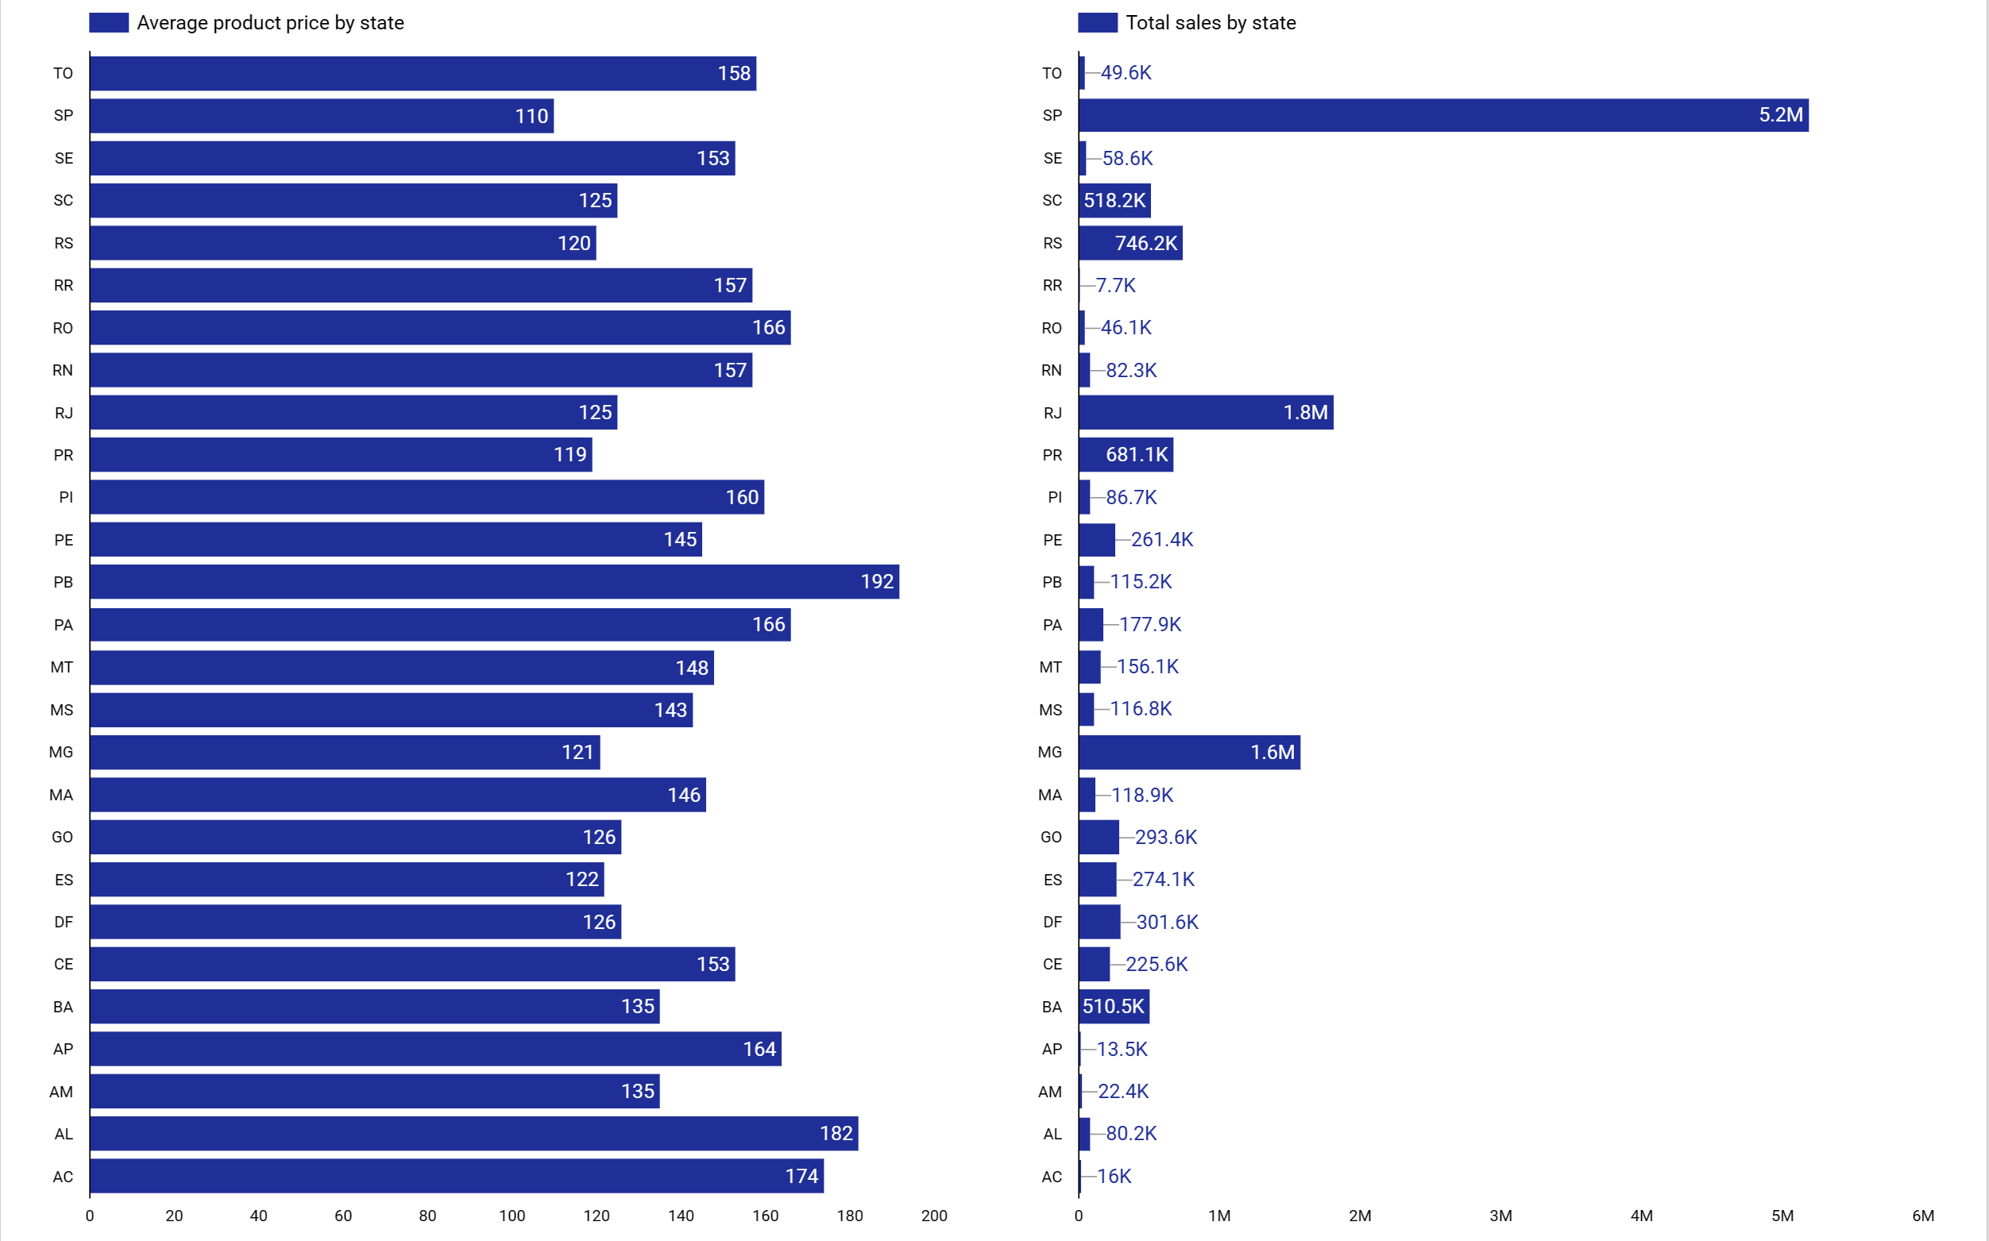
Average price vs Total sales

Slide 10
How are the total and average freight values concentrated in Brazilian states?

Slide 11
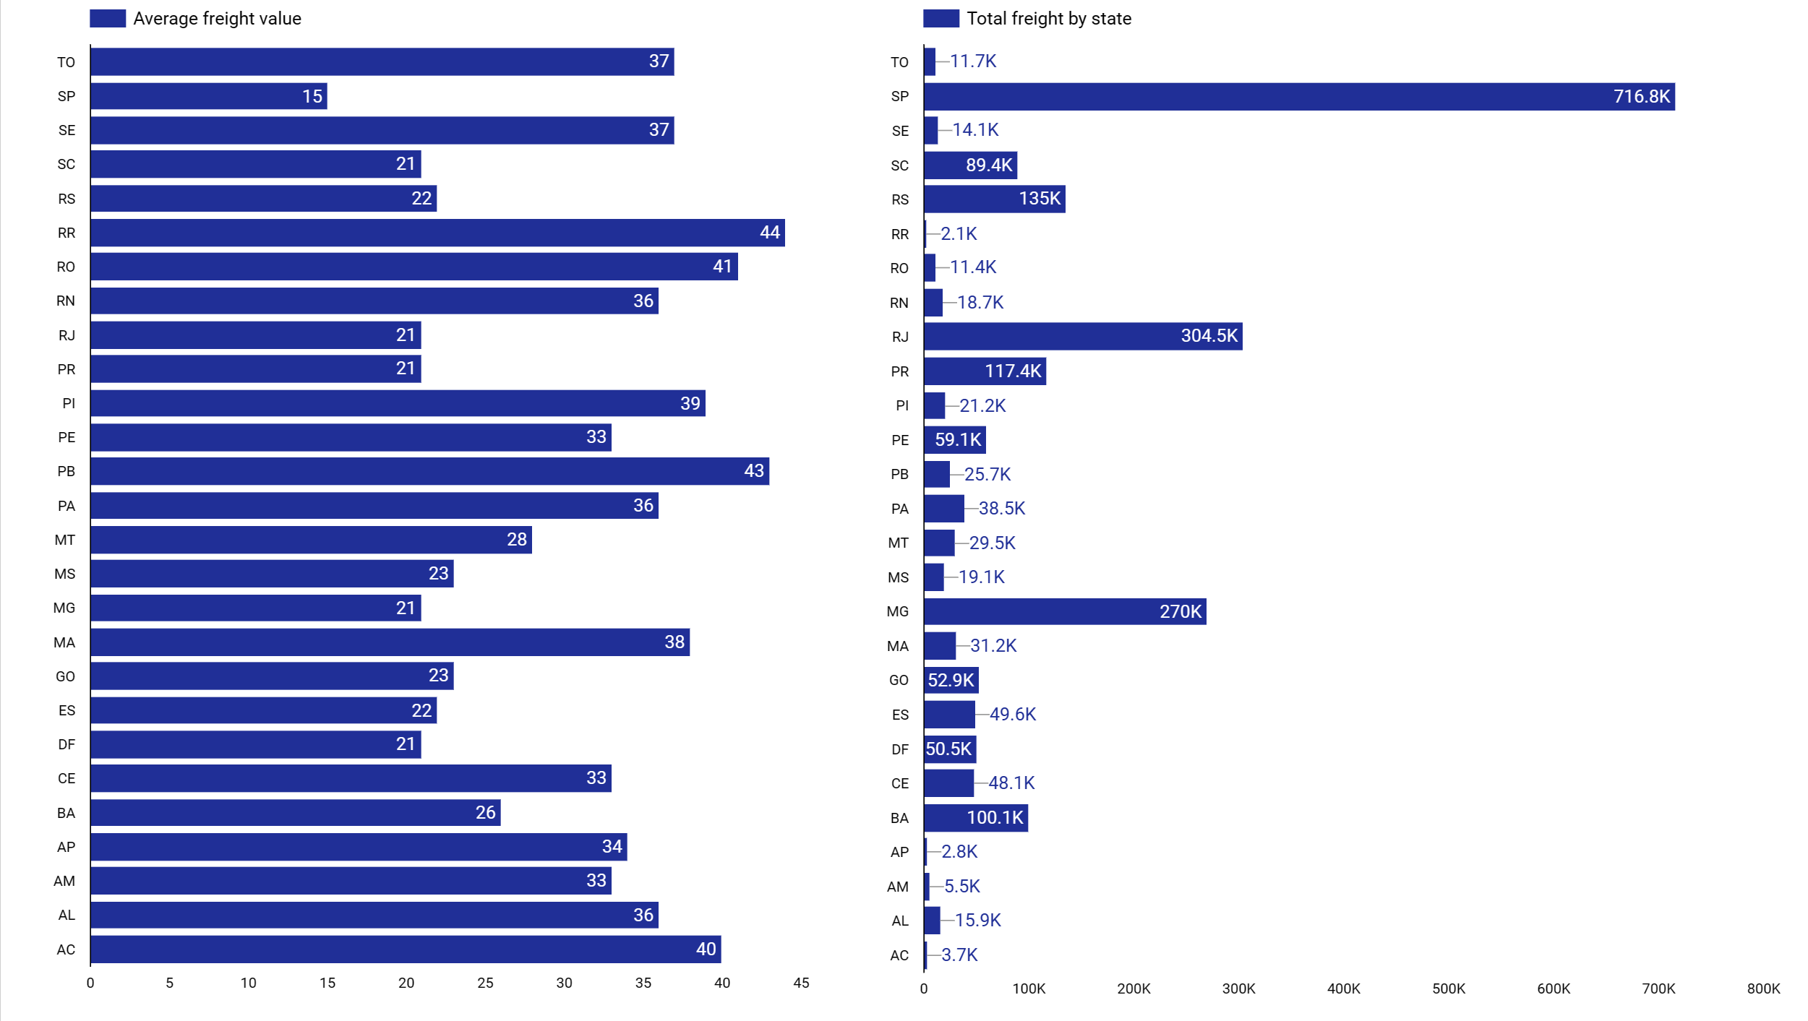
Average freight value vs Total freight by sate

Slide 12
Payment Type Analysis

Slide 13
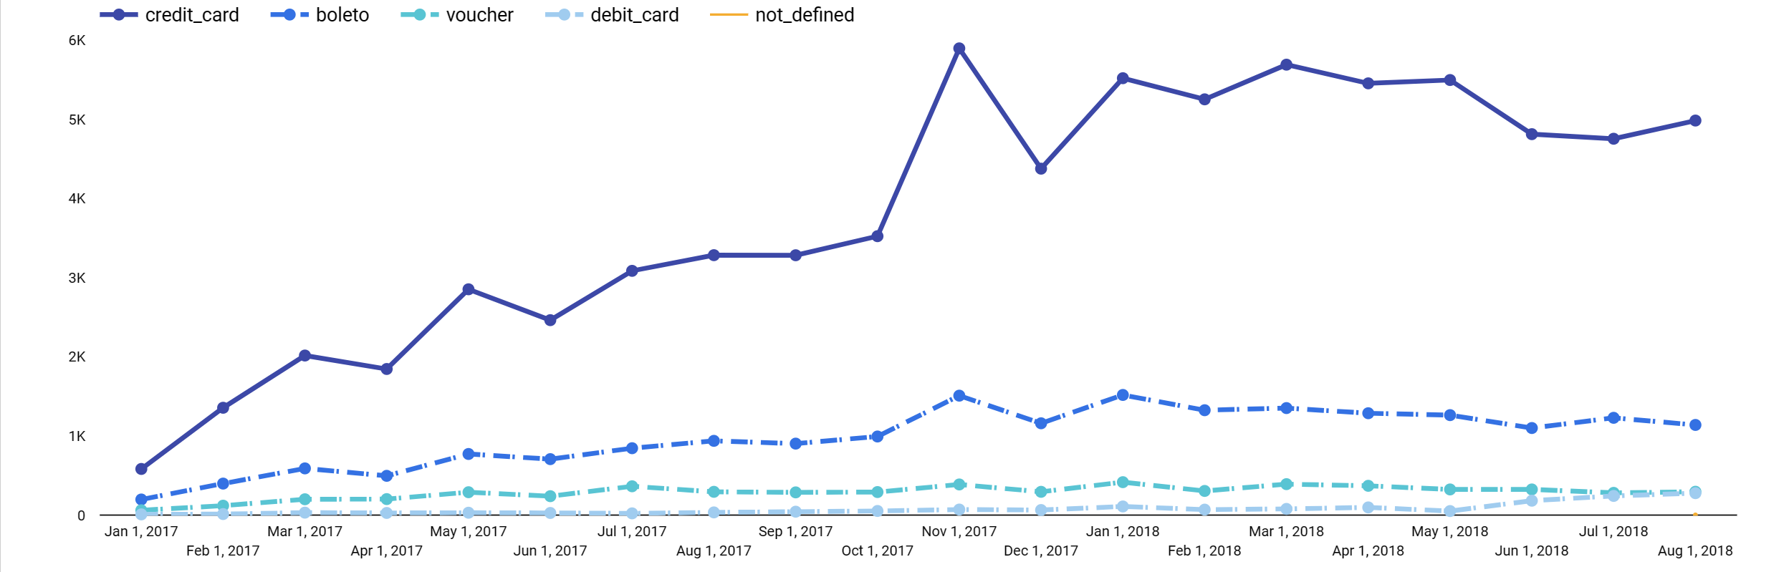
Evolution of payment type between 2017-2018

Slide 14
Payment type
Total of 103.9k payments registered
74%
19%
6%
1.5%
Credit card
Boleto
Voucher
Debit card
76k payment registered
19k payment registered
5,7k payment registered
1,5k payment registered

Slide 15
How does payment type & payment instalment influence the order status

Slide 16
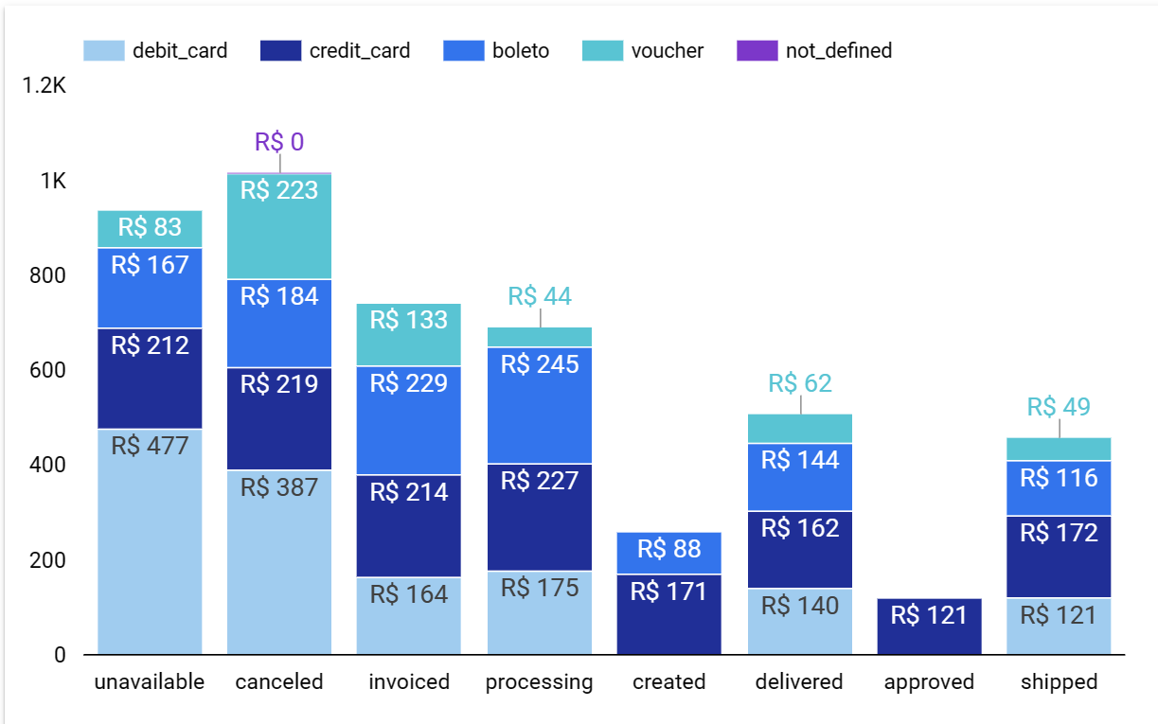

Slide 17
Top 5 Payment installment distribution
51%
12%
10%
7%
5,1%
5%
1
2
3
4
10
5

Slide 18
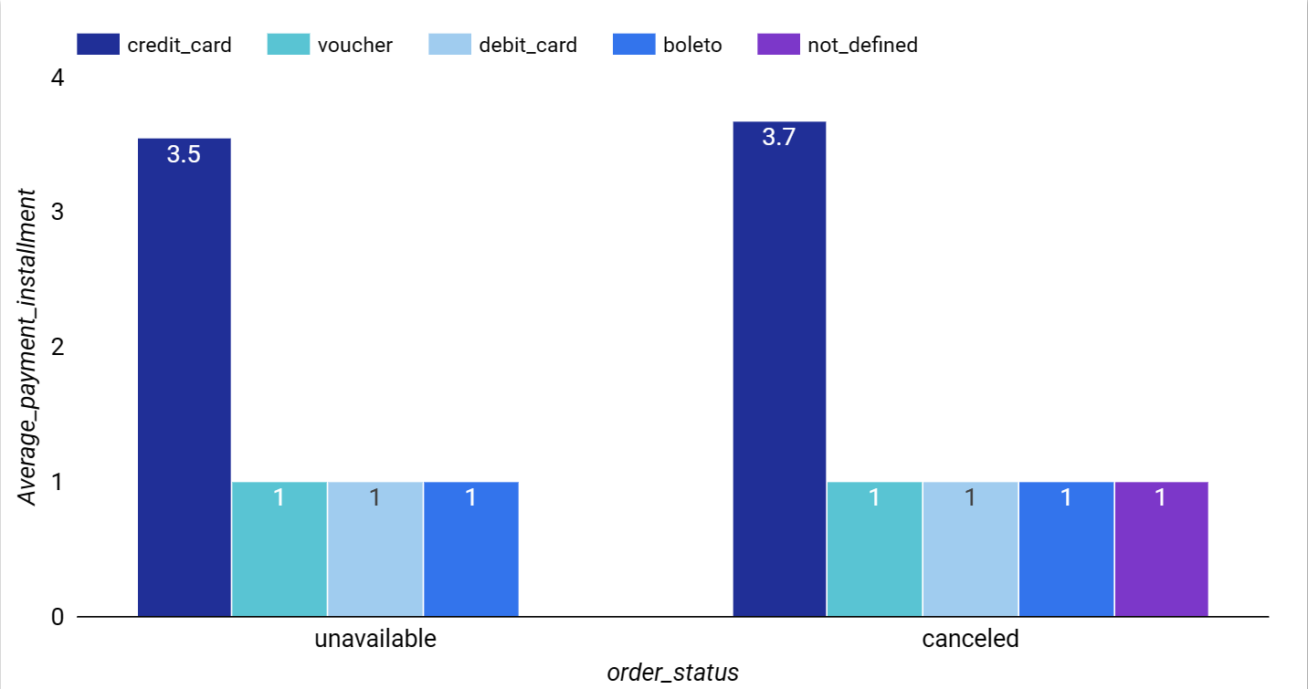
Payment instalments which were cancelled

Slide 19
Sales forecast for the upcoming months

Slide 20
- Exponential growth from 2017 Jan-Aug to 2018 Jan-Aug: 142 % compared to last year. - Highest sales opportunity in November due to the Black Friday campaign. - Average order value and freight value significantly affect the total sales in the specific continent great opportunity to optimize the order value for maximum profit and sales. - Need to optimize the payment gateway to accept the transaction faster, especially the average order value for a customer of more than 200. -Sales forecasting shows a strong possibility of sales growth in the upcoming months.

